Slide 1
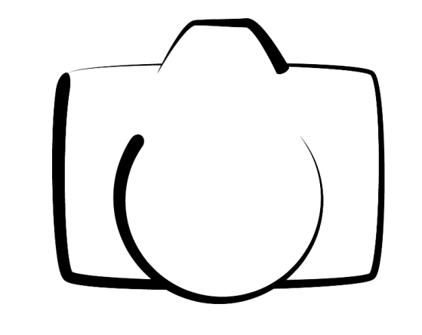
ROSI PHOTOGRAPHY
SPA APPLICATION (MEAN Stack)

Slide 2

SKELETON OF APP
MongoDB
ExpressJS
AngularJS
NodeJS

Slide 3
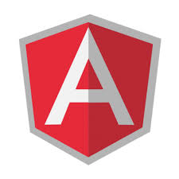

MAINLY USED LANGUAGES
Stylus
Jade
AngularJS
Jquery

